Slide 1
KuBo CI/CD Pipeline with Jenkins
CNABU
09/07/2017
V1.0

Slide 2



Kubo Deployment
Harbor
10.40.206.145
Bosh Director
10.40.206.147
Jenkins
10.40.206.149
10.40.206.128/25
K8s Cluster-1 (mykubocluster-1)
DVS P-G PG-MGMT-Client
master-haproxy 10.40.207.42
master
master
etcd
etcd
etcd
worker-haproxy
worker
worker
worker
vCenter
10.40.206.23
Bosh Client
10.40.206.8
10.40.206.0/25
10.40.207.0/24
DVS P-G PG-MGMT-Server
DVS P-G PG-COMP-VM-1
MGMT Cluster
COMPUTE Cluster
Physical Router

Slide 3
KuBo Deployment – High Level Steps
Deploy Bosh Client
Deploy Bosh Director
Deploy K8s Clusters

Slide 4
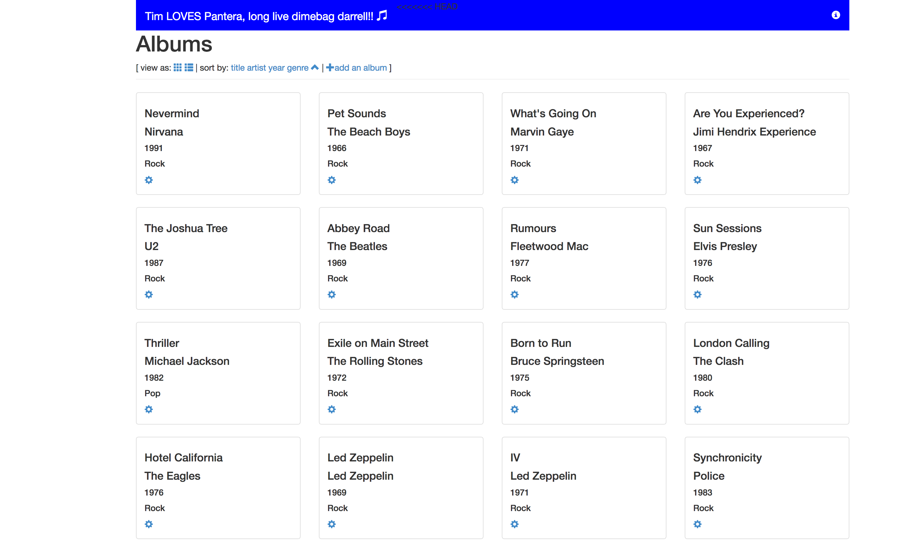
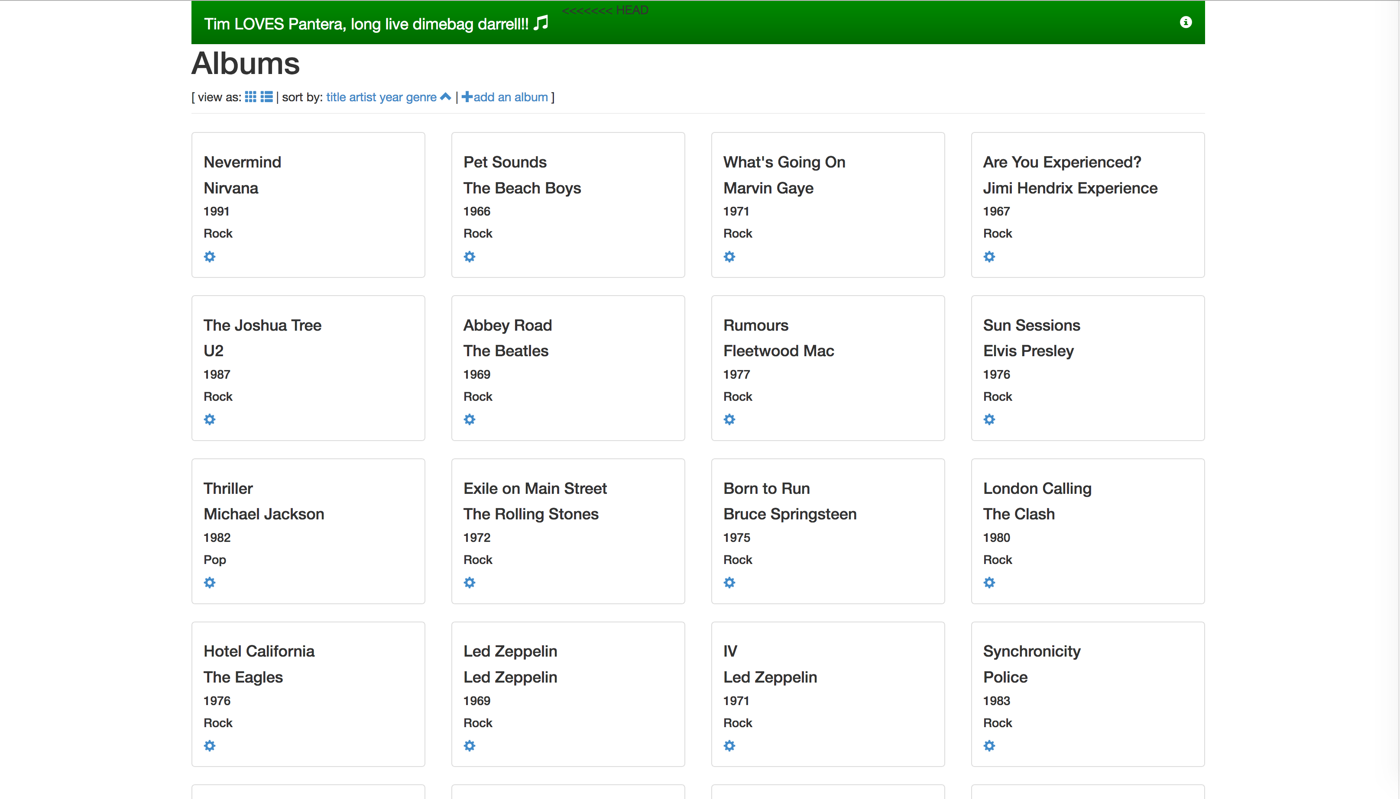





Developer App (spring-music v1)
Developer App (spring-music v2)
K8s Cluster
5/ Update Image to current deployment
1/ Deploy the App
2/ makeItGreen.sh
3/ WebHook
(or poll from Jenkins)
Source Code Control
4/ Build new image (spring-music v2) Push to registry
Private Registry
CI/CD
Developer

Slide 5
Q&A

